Slide 1
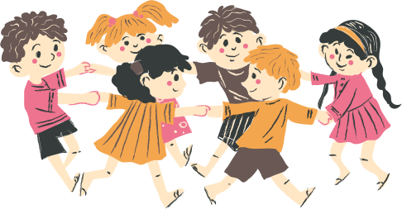
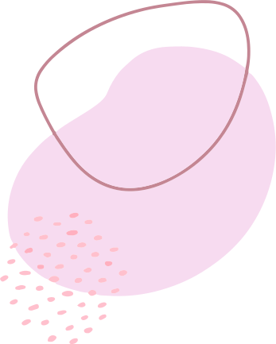
ATTACHMENT

Slide 2
What does attachment do?
According to The Developing Mind
Infants uses an attachment figure's (parents, caregivers, therapists) state of mind to regulate.
"Infant attachment studies remind us of the crucial important of attuned nonverbal communication in all forms of human relationships "
What does this reminds you of?
How do you use this information in your work?
Notes:
Attachment is basically "attunement" - the book talked about how it aligns states of mind. So if you are calm, the child is calm.
For the nonverbal infant, communication is done without words. E.g. peekaboo, exaggerated facial expressions etc.

Slide 5
Secure Attachment
Children distressed when parents were gone
Children greets parents actively, usually initiating physical contact
Children quickly soothed and return rapidly to play
Parents were sensitive to the children's signals
Parents were emotionally available, perceptive, and effective at meeting the children's needs

Slide 6
Avoidant Attachment
Children fails to cry when parents were gone
Children ignore the return of their parents
Minimize proximity seeking with parents
Response to parents appears unemotional
Parents were emotionally unavailable, imperceptive, rejecting and unresponsive
Such parents demonstrated low degrees of affect attunement

Slide 7
Ambivalent Attachment
May be wary or distressed prior to separation, little exploration in the room
Preoccupied with parents throughout procedure, may seem angry or passive
Fails to settle and take comfort in parent during reunion
Response to parents appears unemotional
Parents were inconsistently available, perceptive and responsive

Slide 8
Disorganized/Disordered Attachment
Children appears disorganized and disoriented during return of parents
E.g. spinning in circles, approaching and then avoiding parents, freezing
Parents who show frightened or disorientated communications during first year of life
Child's sense of self can be described as fragmented
Associated with serious family dysfunction

Slide 9
How does attachment affects children?
Secure
Avoidant
Most likely to have the best outcome; better adjusted and more socially skilled
Controlling, aggressive, and disliked by peers
Ambivalent
Disorganize
Social competence may be compromised
Predisposition for social anxiety
Most difficulty in life
Highest likelihood of having clinical difficulties

Slide 10
THANK YOU!
THOUGHTS?

